Slide 1
Training/Testing and Regularization
Il-Chul Moon Dept. of Industrial and Systems Engineering KAIST
icmoon@kaist.ac.kr

Slide 2
Weekly Objectives
Understand the concept of bias and variance
Know the concept of over-fitting and under-fitting
Able to segment two sources, bias and variance, of error
Understand the bias and variance trade-off
Understand the concept of Occam’s razor
Able to perform cross-validation
Know various performance metrics for supervised machine learning
Understand the concept of regularization
Know how to apply regularization to
Linear regression
Logistic regression
Support vector machine

Slide 3
Concept of bias and variance

Slide 4
Up To This Point…
Now, you are supposed to have some knowledge in classifications
Naïve Bayes
Logistic Regression
Support Vector Machine
SVM is still a commonly used machine learning algorithm for classifications
Functioning is kind of done
Efficiency and accuracy now becomes a problem

Slide 5
Better Machine Learning Approach?
Accurate prediction result
Ex) with this NB classifier, I can filter spams with 95% accuracy!
Is this a right claim?
The validity of accuracy
No clear definition
Why not use other performance metrics? Such as Precision/Recall, F-Measure
The validity of dataset
Spams??
How many spams?
Where did you gathered?
Big variance in the spams?
Is the spam mail evolving?
From Nigerian prince scheme to something else?

Slide 6
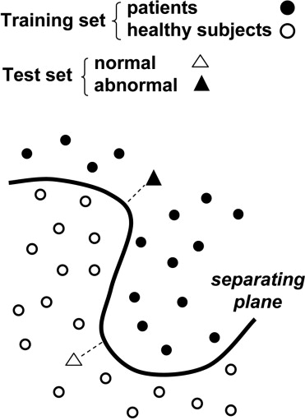
Training and Testing
Training
Parameter inference procedure
Prior knowledge, past experience
There is no guarantee that this will work in the future
ML’s Achilles gun is the stable/static distribution of learning targets.
Why ML does not work in the future?
The domain changes, or the current domain does not show enough variance
The ML algorithms inherently have problems
Testing
Testing the learned ML algorithms/the inferred parameters
New dataset that is unrelated to the training process
Imitating the future instances
By setting aside a subset of observations

Slide 7
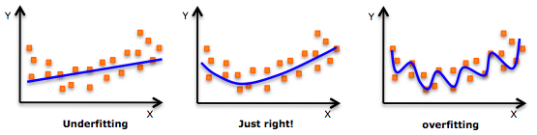
Over-Fitting and Under-Fitting
Imaging this scenario
You are given N points to train a ML algorithm
You are going to learn a simple polynomial regression function
Y=F(x)
The degree of F is undetermined. Can be linear or non-linear
Considering the three Fs in the below, which looks better?

Slide 8
Tuning Model Complexity
One degree, two degree, and N degree trained functions
As the degree increases, the model becomes complex
Is complex model better?
Then, where do we stop in developing a complex model?
Is there any measure to calculate the complexity and the generality?
There is a trade-off between the complexity of a model and the generality of a dataset.

Slide 9
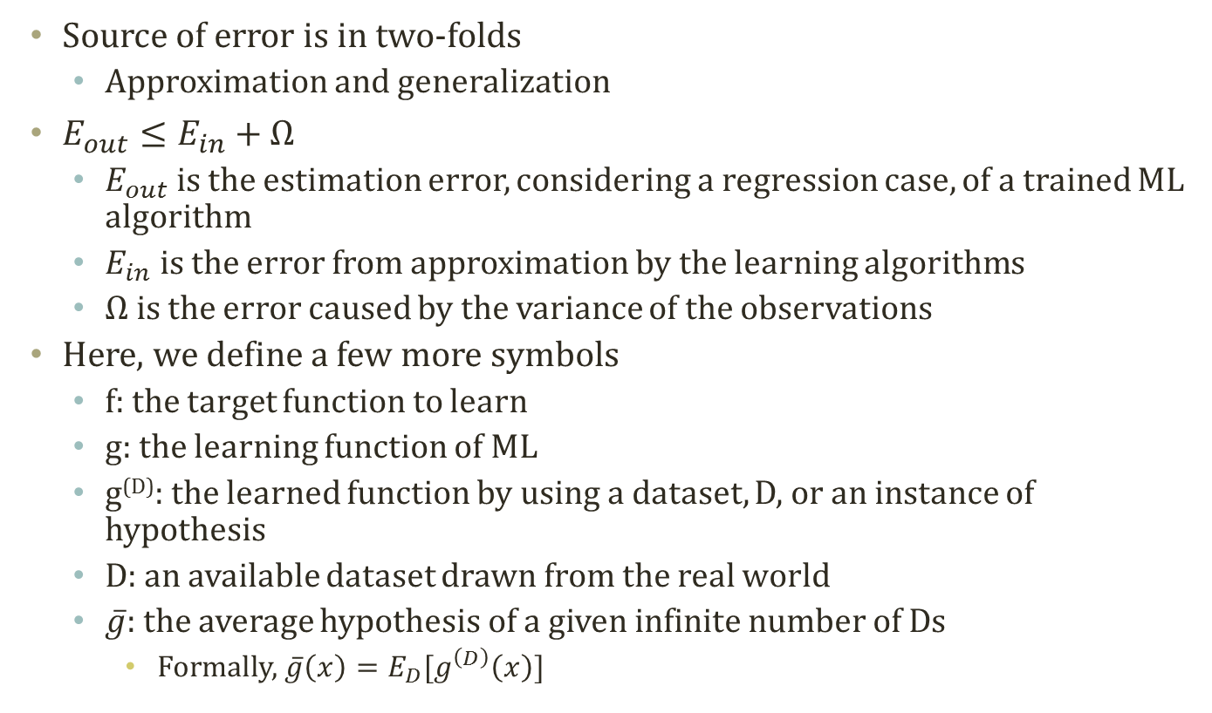
Sources of Error in ML
Source of error is in two-folds
Approximation and generalization
$E_{out}≤E_{in}+Ω$
$E_{out}$ is the estimation error, considering a regression case, of a trained ML algorithm
$E_{in}$ is the error from approximation by the learning algorithms
$Ω$ is the error caused by the variance of the observations
Here, we define a few more symbols
f: the target function to learn
g: the learning function of ML
g^{(D)}: the learned function by using a dataset, D, or an instance of hypothesis
D: an available dataset drawn from the real world
$\overline{g}$: the average hypothesis of a given infinite number of Ds
Formally, $\overline{g}\left(x\right)=E_{D}[g^{\left(D\right)}\left(x\right)]$

Slide 10
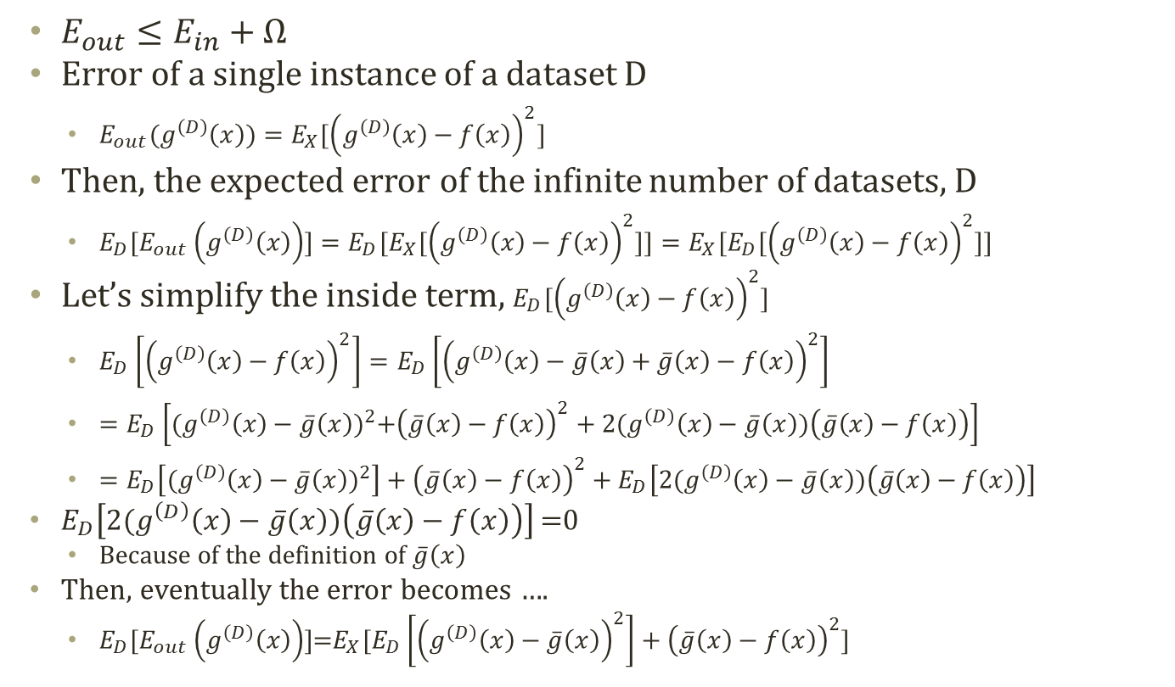
Bias and Variance
$E_{out}≤E_{in}+Ω$
Error of a single instance of a dataset D
$E_{out}(g^{\left(D\right)}\left(x\right))=E_{X}[{\left(g^{\left(D\right)}\left(x\right)−f\left(x\right)\right)}^{2}]$
Then, the expected error of the infinite number of datasets, D
$E_{D}[E_{out}\left(g^{\left(D\right)}\left(x\right)\right)]={E_{D}[E}_{X}[{\left(g^{\left(D\right)}\left(x\right)−f\left(x\right)\right)}^{2}]]=E_{X}[E_{D}[{\left(g^{\left(D\right)}\left(x\right)−f\left(x\right)\right)}^{2}]]$
Let’s simplify the inside term, $E_{D}[{\left(g^{\left(D\right)}\left(x\right)−f\left(x\right)\right)}^{2}]$
$E_{D}\left[{\left(g^{\left(D\right)}\left(x\right)−f\left(x\right)\right)}^{2}\right]=E_{D}\left[{\left(g^{\left(D\right)}\left(x\right)−\overline{g}\left(x\right)+\overline{g}\left(x\right)−f\left(x\right)\right)}^{2}\right]$
$=E_{D}\left[{(g^{\left(D\right)}\left(x\right)−\overline{g}\left(x\right))}^{2}+{\left(\overline{g}\left(x\right)−f\left(x\right)\right)}^{2}+2(g^{\left(D\right)}\left(x\right)−\overline{g}\left(x\right))\left(\overline{g}\left(x\right)−f\left(x\right)\right)\right]$
$=E_{D}\left[{(g^{\left(D\right)}\left(x\right)−\overline{g}\left(x\right))}^{2}\right]+{\left(\overline{g}\left(x\right)−f\left(x\right)\right)}^{2}+E_{D}\left[2(g^{\left(D\right)}\left(x\right)−\overline{g}\left(x\right))\left(\overline{g}\left(x\right)−f\left(x\right)\right)\right]$
$E_{D}\left[2(g^{\left(D\right)}\left(x\right)−\overline{g}\left(x\right))\left(\overline{g}\left(x\right)−f\left(x\right)\right)\right]$ =0
Because of the definition of $\overline{g}\left(x\right)$
Then, eventually the error becomes ….
$E_{D}[E_{out}\left(g^{\left(D\right)}\left(x\right)\right)]$=$E_{X}[E_{D}\left[{\left(g^{\left(D\right)}\left(x\right)−\overline{g}\left(x\right)\right)}^{2}\right]+{\left(\overline{g}\left(x\right)−f\left(x\right)\right)}^{2}]$

Slide 11
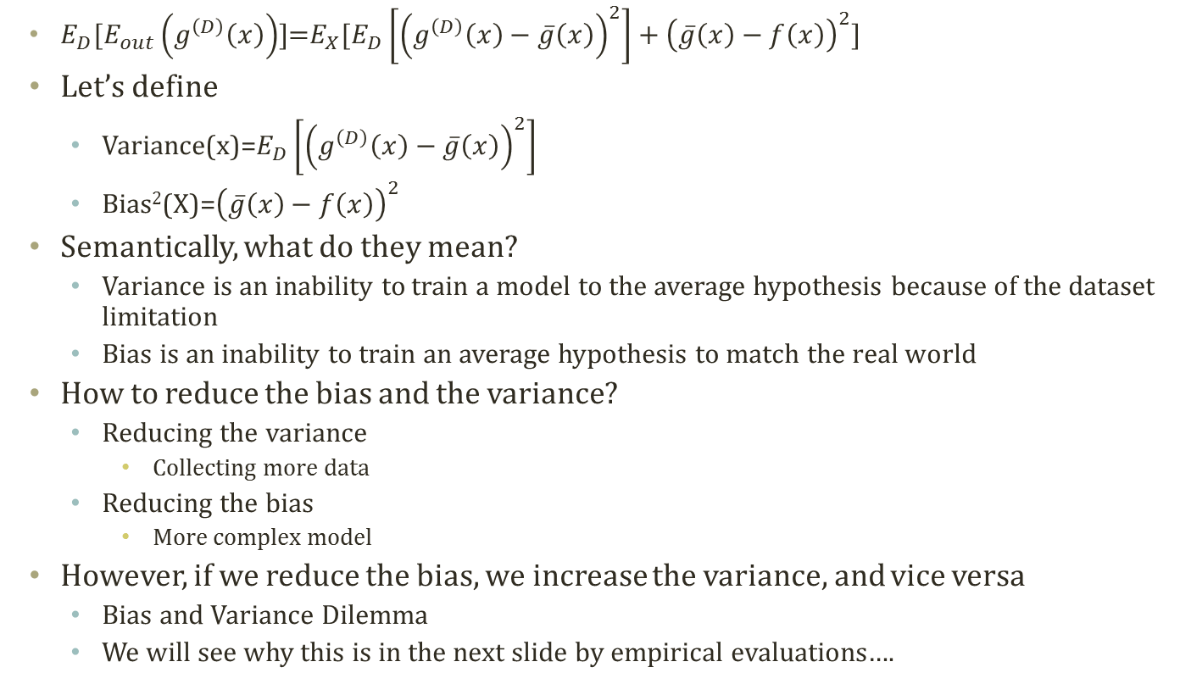
Bias and Variance Dilemma
$E_{D}[E_{out}\left(g^{\left(D\right)}\left(x\right)\right)]$=$E_{X}[E_{D}\left[{\left(g^{\left(D\right)}\left(x\right)−\overline{g}\left(x\right)\right)}^{2}\right]+{\left(\overline{g}\left(x\right)−f\left(x\right)\right)}^{2}]$
Let’s define
Variance(x)=$E_{D}\left[{\left(g^{\left(D\right)}\left(x\right)−\overline{g}\left(x\right)\right)}^{2}\right]$
Bias²(X)=${\left(\overline{g}\left(x\right)−f\left(x\right)\right)}^{2}$
Semantically, what do they mean?
Variance is an inability to train a model to the average hypothesis because of the dataset limitation
Bias is an inability to train an average hypothesis to match the real world
How to reduce the bias and the variance?
Reducing the variance
Collecting more data
Reducing the bias
More complex model
However, if we reduce the bias, we increase the variance, and vice versa
Bias and Variance Dilemma
We will see why this is in the next slide by empirical evaluations….

Slide 12
Performance Measurement

Slide 13
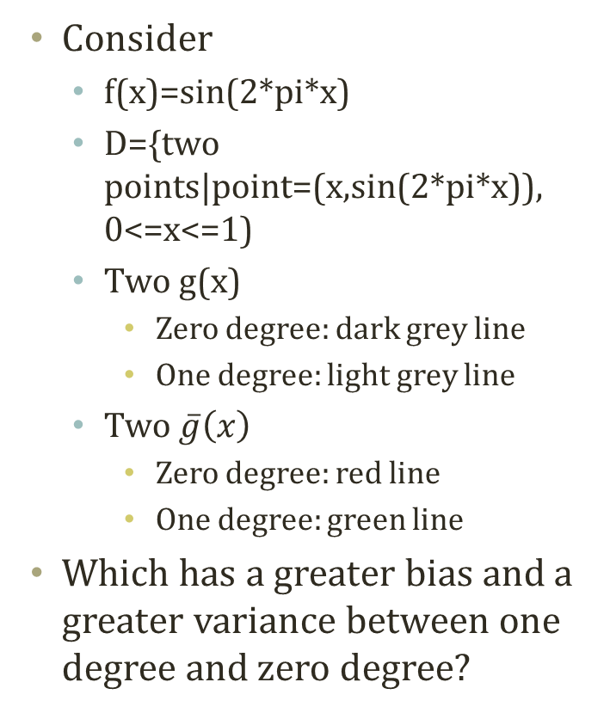
Empirical Bias and Variance Trade-off
Consider
f(x)=sin(2*pi*x)
D={two points|point=(x,sin(2*pi*x)), 0<=x<=1)
Two g(x)
Zero degree: dark grey line
One degree: light grey line
Two $\overline{g}\left(x\right)$
Zero degree: red line
One degree: green line
Which has a greater bias and a greater variance between one degree and zero degree?

Slide 14
Bias and Variance of Two Hypotheses
Bias = 0.5051
Var. = 0.2410
Bias = 0.3092
Var. = 2.0708
A complex model has a higher variance and a lower bias.
A simple model has a lower variance and a higher bias.
Need a balance in the complexity of a ML algorithm

Slide 15
Occam’s Razor
Occam’s Razor
Among competing hypotheses, the one which makes the fewest assumption should be selected
Competing?
Relevantly similar error in the prediction
Fewest assumption
Less complex model
Given the approximately same error, a simple model should be selected
Reflection of Bias and Variance tradeoff!
By the way, is it possible to calculate the bias and the variance in the real world setting?

Slide 16
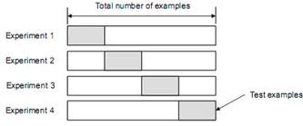
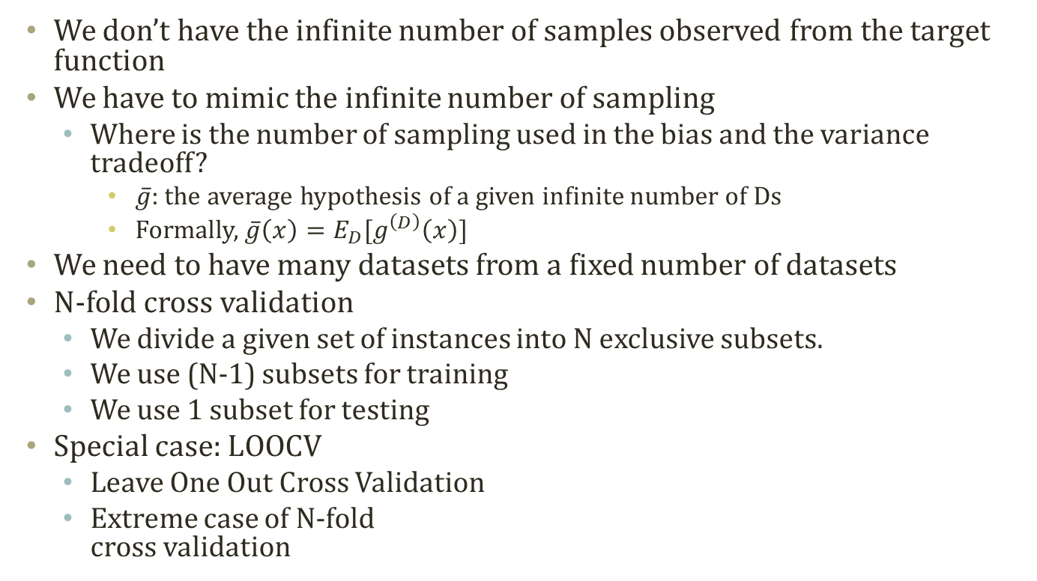
Cross Validation
We don’t have the infinite number of samples observed from the target function
We have to mimic the infinite number of sampling
Where is the number of sampling used in the bias and the variance tradeoff?
$\overline{g}$: the average hypothesis of a given infinite number of Ds
Formally, $\overline{g}\left(x\right)=E_{D}[g^{\left(D\right)}\left(x\right)]$
We need to have many datasets from a fixed number of datasets
N-fold cross validation
We divide a given set of instances into N exclusive subsets.
We use (N-1) subsets for training
We use 1 subset for testing
Special case: LOOCV
Leave One Out Cross Validation
Extreme case of N-fold cross validation

Slide 17
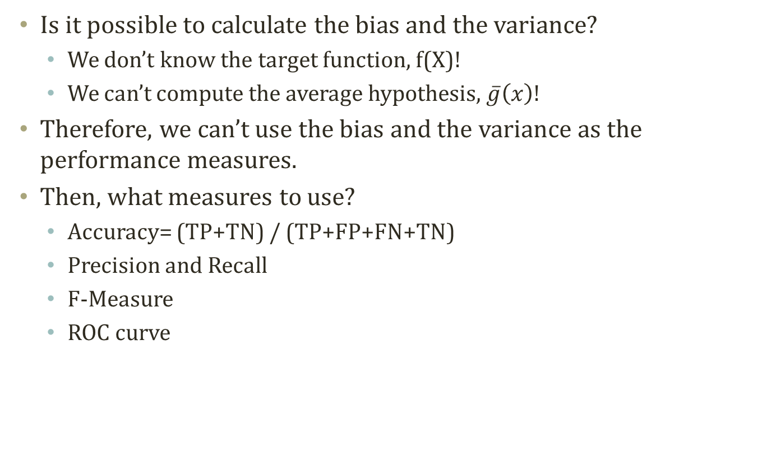
Performance Measure of ML
Is it possible to calculate the bias and the variance?
We don’t know the target function, f(X)!
We can’t compute the average hypothesis, $\overline{g}\left(x\right)$!
Therefore, we can’t use the bias and the variance as the performance measures.
Then, what measures to use?
Accuracy= (TP+TN) / (TP+FP+FN+TN)
Precision and Recall
F-Measure
ROC curve
 |  | Actual Value
 |  | True | False
Estimated Value | Positive | True Positive | False Positive
 | Negative | False Negative | True Negative
①
②
③
④

Slide 18
Precision and Recall
 |  | Actual Value
 |  | True | False
Estimated Value | Positive | True Positive | False Positive
 | Negative | False Negative | True Negative
Consider the two cases
Building a classifier
Spam filter
CRM
Goals are slightly different
Spam filter: classifying spam
Safety is first. You don’t want to throw out valid emails estimated as spams
Reducing the FP is the priority
CRM: classifying VIP customer
Reaching out is first. You don’t want to miss any VIP customers as ordinary ones
Reducing the FN is the priority
Precision = TP / (TP+FP)
Recall = TP / (TP+FN)
Then, which metrics to use in each case?

Slide 19
F-Measure
Precision and recall are popular metrics, but it has problems in the applications
The most safest spam filter == always say ‘no spam’
The most reaching-out customer filter == always say ‘VIP’
We need a measure that balances the precision and the recall performance
F-Measure is the derived metric from the precision and the recall
F_{b}-Measure = (1+b²) * (Precision * Recall) / (b²*Precision + Recall)
F₁-Measure= 2 * (Precision * Recall) / (Precision + Recall)
F_{0.5} and F₂ are also used.
F₂ emphasizes recall
F_{0.5} emphasizes precision

Slide 20
Model regularization

Slide 21
Concept of Regularization
Disaster in terms of variance
With regularization
We sacrifice the perfect fit
Reducing the training accuracy
We increase the potential fit in the test
Because of the increased model complexity, the bias tends to increase a little bit
Eventually, regularization is another constraint for models
Existing constraint?
Minimizing error from training set
We add a new term to the MSE

Slide 22
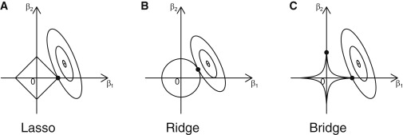
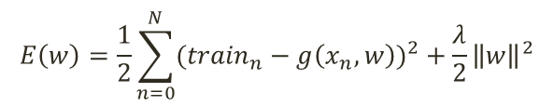
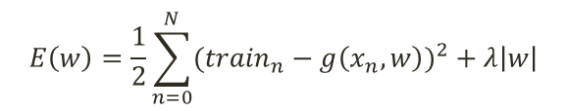
Formal Definition of Regularization
Regularization is another constraint for the regression
The below J(B) is the regularization function to minimize
B is the weight of the regression model except the constant term
There are diverse regularization
L1 Regularization == Lasso regularization
The first order
L2 Regularization == Ridge regularization
The second order
Depends on the order of the regularization term
The order determines the shape of the loss function
$$E\left(w\right)=\frac{1}{2}\sum_{n=0}^{N}{{({train}_{n}−g\left(x_{n},w\right))}^{2}}+\frac{λ}{2}{\left\|w\right\|}^{2}$$
$$E\left(w\right)=\frac{1}{2}\sum_{n=0}^{N}{{({train}_{n}−g\left(x_{n},w\right))}^{2}}+λ\left|w\right|$$

Slide 23

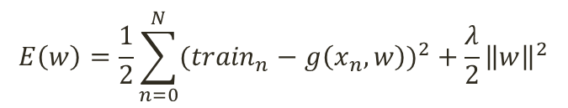

Regularization of Linear Regression
Let’s apply the regularization idea to the linear regression
We can calculate w in the closed form.
$$E\left(w\right)=\frac{1}{2}\sum_{n=0}^{N}{{({train}_{n}−g\left(x_{n},w\right))}^{2}}+\frac{λ}{2}{\left\|w\right\|}^{2}$$
$$\frac{d}{dw}E\left(w\right)=0$$
$$\frac{d}{dw}E\left(w\right)=\frac{d}{dw}\left(\frac{1}{2}{\left\|train−Xw\right\|}^{2}+\frac{λ}{2}{\left\|w\right\|}^{2}\right)$$
$$=\frac{d}{dw}\left(\frac{1}{2}{\left\|train−Xw\right\|}^{T}\left\|train−Xw\right\|+\frac{λ}{2}w^{T}w\right)$$
$$=\frac{d}{dw}\left(\frac{1}{2}({train}^{T}train−2X^{T}w∙train+X^{T}Xw^{T}w)+\frac{λ}{2}w^{T}w\right)$$
$$=\frac{d}{dw}\left({train}^{T}train−X^{T}w∙train+\frac{1}{2}X^{T}Xw^{T}w+\frac{λ}{2}w^{T}w\right)$$
$$=−X^{T}∙train+X^{T}Xw+λw=0$$
$$−X^{T}∙train+X^{T}Xw+λIw=0$$
$$−X^{T}∙train+(X^{T}X+λI)w=0$$
$$\left(X^{T}X+λI\right)w=X^{T}∙train$$
$$w={\left(X^{T}X+λI\right)}^{−1}X^{T}∙train$$

Slide 24
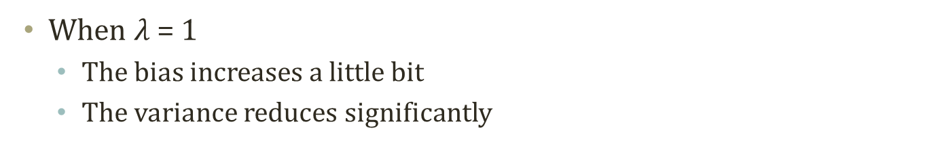
Effect of Regularization
Bias = 0.3092
Var. = 2.0708
Bias = 0.4372
Var. = 0.1167
When $λ$ = 1
The bias increases a little bit
The variance reduces significantly

Slide 25

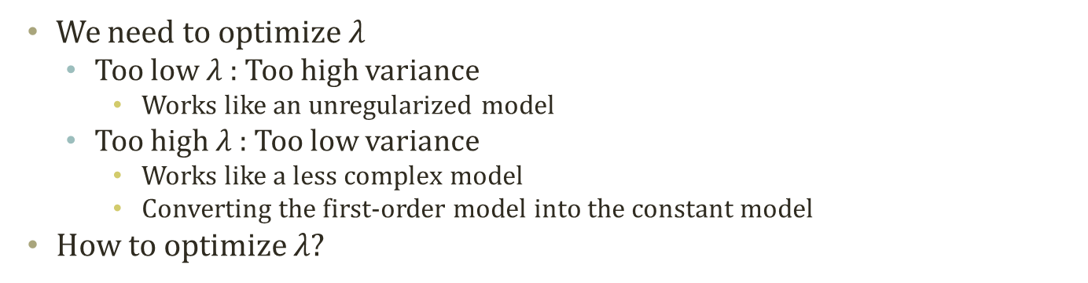


Optimizing the Regularization
$λ$ = 0
$λ$ = 1
$λ$ = 100
We need to optimize $λ$
Too low $λ$: Too high variance
Works like an unregularized model
Too high $λ$: Too low variance
Works like a less complex model
Converting the first-order model into the constant model
How to optimize $λ$?

Slide 26

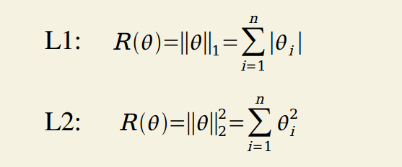
Regularization of Logistic Regression
Regularization is applicable to other models
Such as logistic regression
You can search for the closed form and the approximate form of finding θ

Slide 27

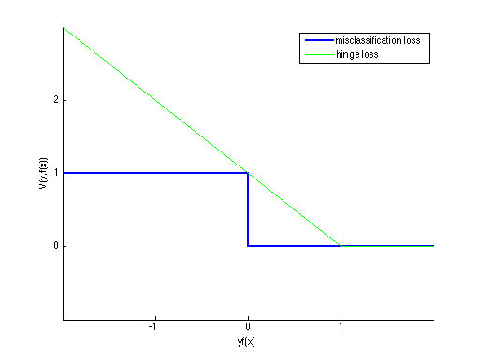



Regularization and SVM
Support vector is a special case of regularization with the hinge loss

Slide 28
Acknowledgement
This slideset is greatly influenced
By Prof. Eric Xing at CMU

